Slide 1

Electrical Machinery Fundamentals
EE 250 SPRING 2020
Lecture 7-Chapter 13
1

Slide 2
Chapter 13 Three-Phase Induction Machines

Slide 3
13.0 Introduction
Comprise both motors and generators
Most frequently encountered in industry
Simple, rugged, low-priced and easy to maintain
Run at constant speed from zero to full load
Speed is frequency dependent (variable frequency electronic drives for speed control)
Chapter overview:
Principle of 3-phase induction motor
Construction of 3-phase induction motor

Slide 4
13.1 Principal components
Two main parts:
Stationary stator
Revolving rotor
Rotor and stator are separated by small air gap that ranges from 0.4mm to 4mm. (Gap depends upon the power of motor)
Stator:
Steel frame
Number of evenly spaced slots for the stator winding
Rotor:
Composed of punched laminations
Two types:
Wound rotor
Conventional 3-phase windings are used just like stator windings
3-wire wye connection
Terminals are connected with three slip rings that are associated with stationary carbon brushes
Stationary brushes enables us to connect external resistance
Squirrel-cage rotor
In small/medium sized motors, bars and end rings are made of die-cast aluminum
Opposite ends of bars are short-circuited by welding them with two copper rings

Slide 5
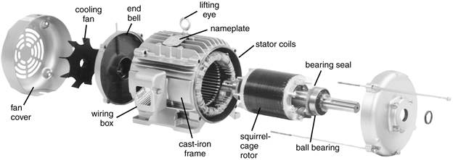
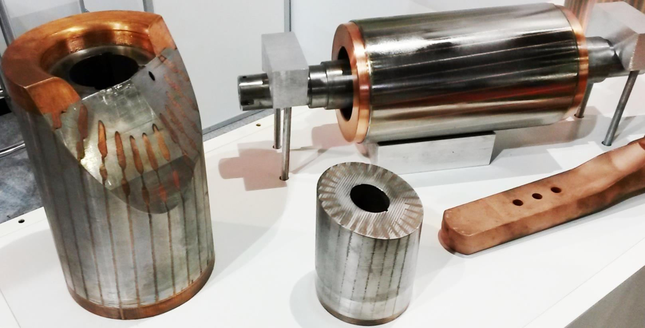
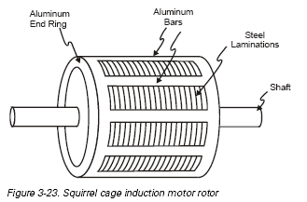
13.1 Principal components Squirrel cage

Slide 6
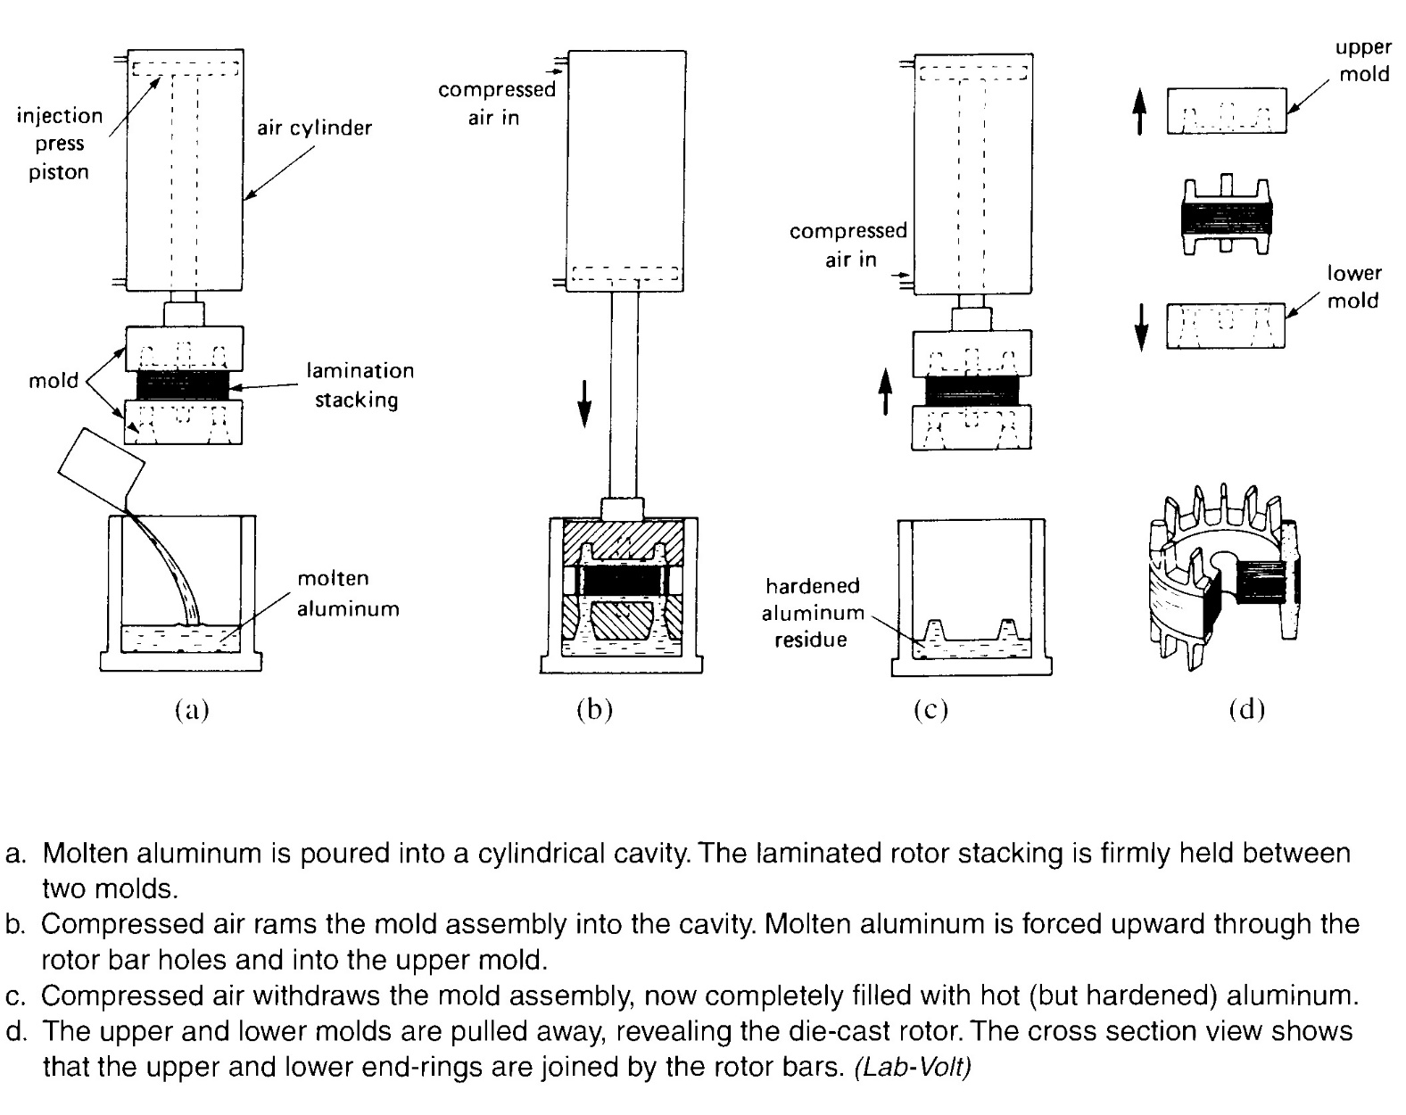
Progressive steps in the injection molding of a squirrel-cage rotor

Slide 7
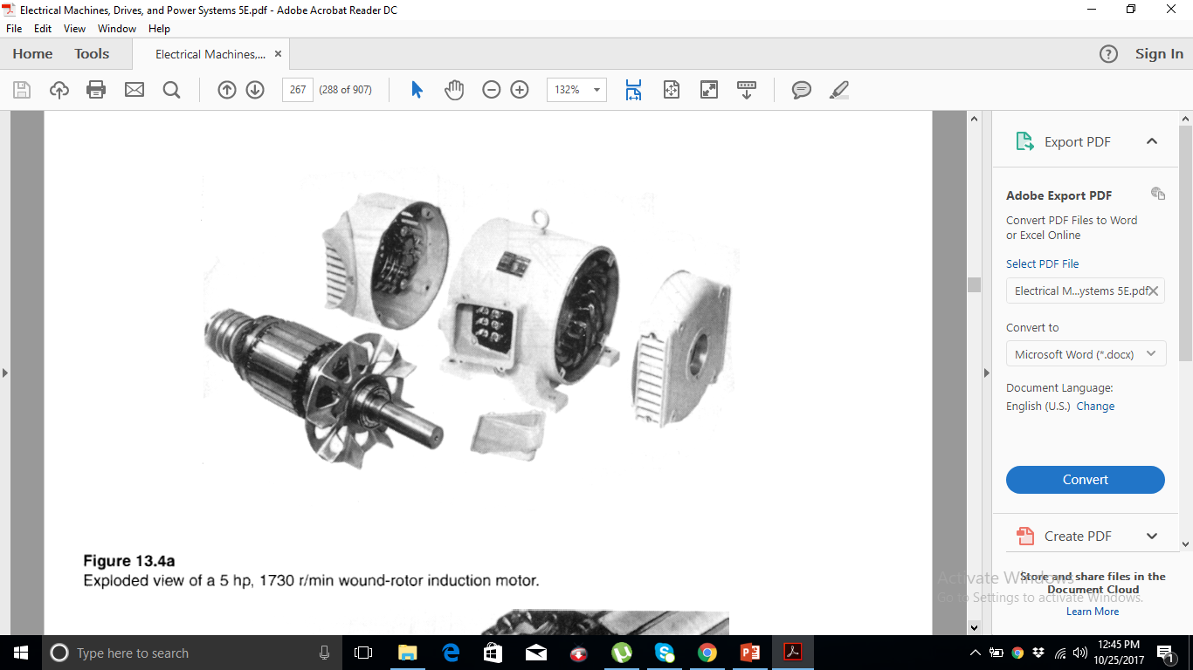
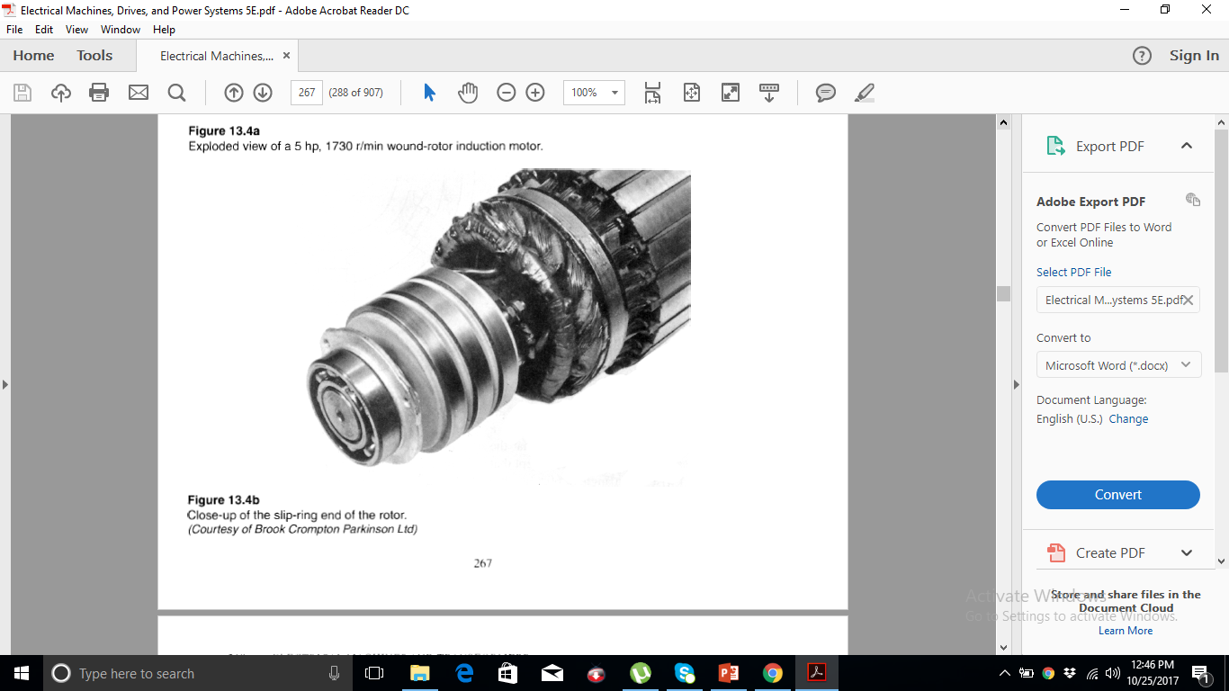
13.1 Principal components Wound rotor

Slide 8
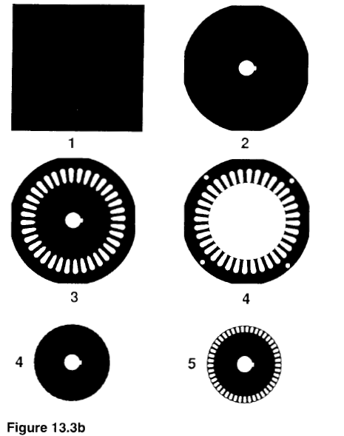
Progressive steps in the manufacture of stator and rotor laminations

Slide 9
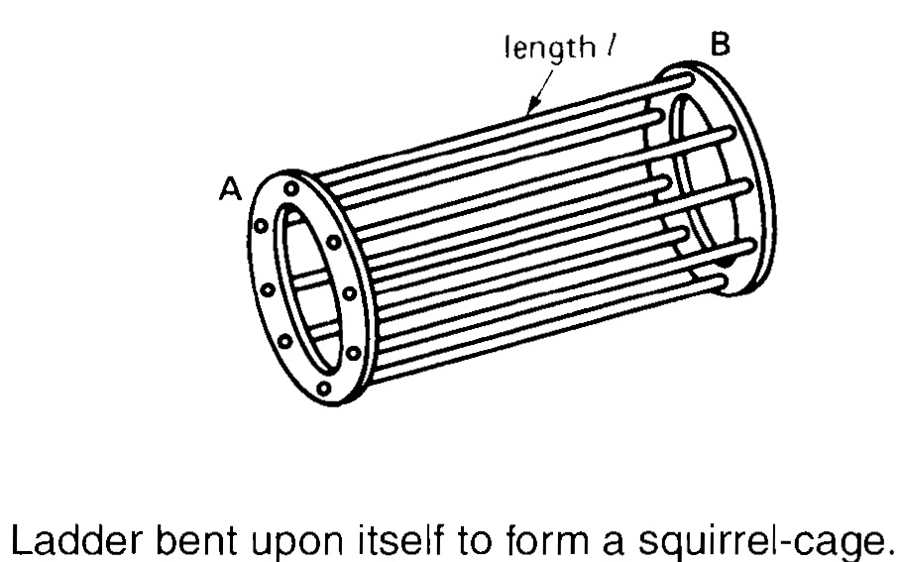
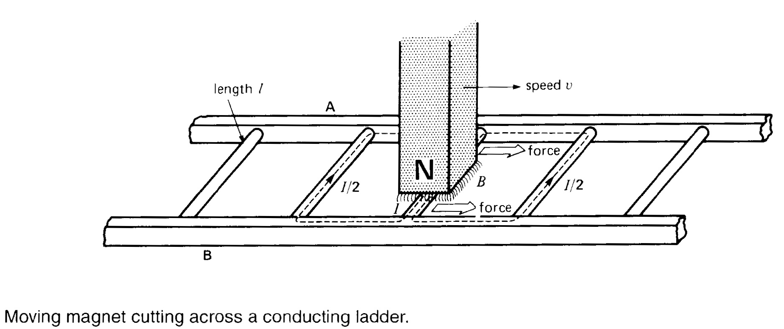
13.2 Principal of operation

Slide 10
13.2 Principal of operation
Operation of three-phase induction motor is based on:
Faraday’s Law
Lorentz force
Conductors of length l with short-circuited extremities
Permanent magnet above the conducting ladder (cage rotor)
Move permanent magnet to right with speed v
Magnetic field B will be swept across the conductors then following phenomenon will happen:
Voltage will be induced in ladder (rotor) conductors
Induced voltage will produce a current in the conductor underneath the pole face that will flow in (ladder) cage
Current carrying conductor (ladder/cage rotor) will experience the force (Lorentz law)
Force will act in the direction to drag the conductor along with the magnetic field (chapter 2)
Non-fixed ladder will move towards which will result in the followings:
Less magnetic will be swept cross the conductors
Less induced voltage, current and force acting on conductors will also decrease
What if ladder is to move at same speed as that of magnetic field?
Induced voltage/ current and dragging force all must become zero

Slide 11
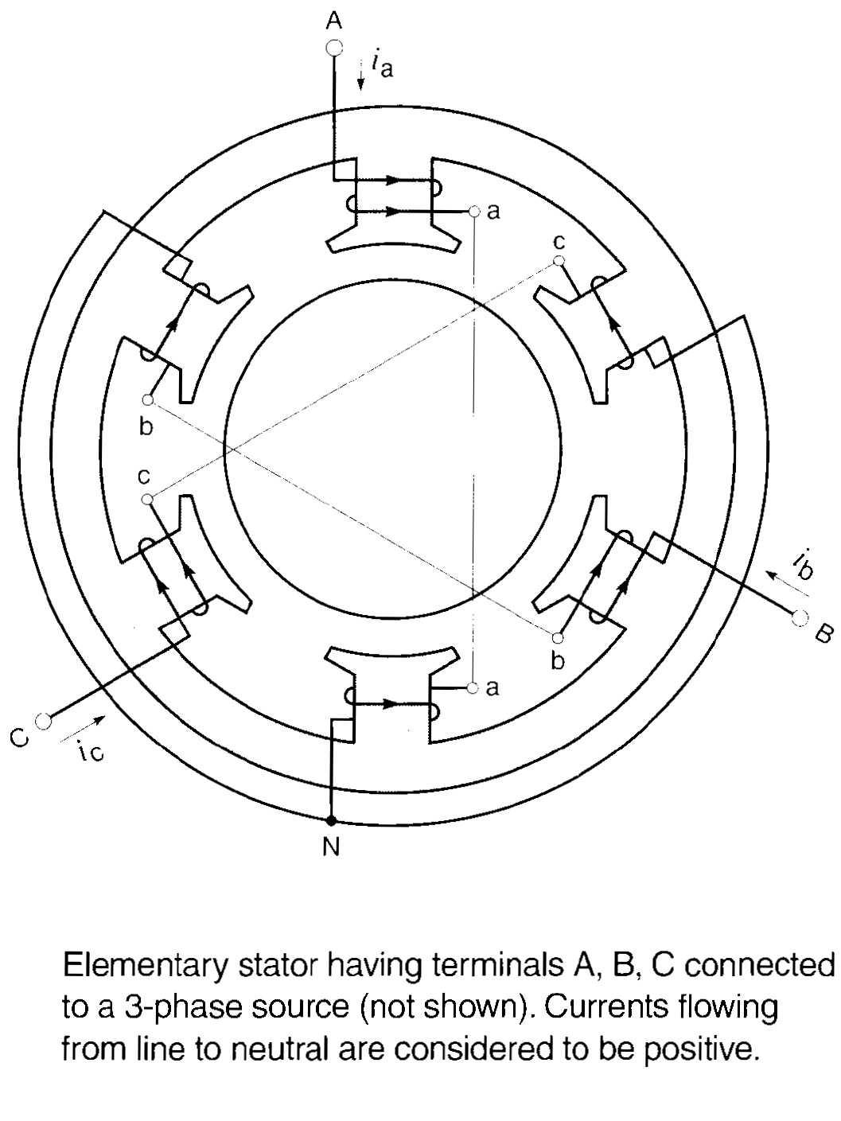
13.3 The rotating field
Construction:
6 salient poles each with 5 turns
6 poles with three windings
One side of each winding is provided with one phase out of three and other ends are common and connected to neutral
Poles are separated by 180°
Three phases of AC supply will be 180° out of phase from each other
mmf is determined by right hand rule

Slide 12
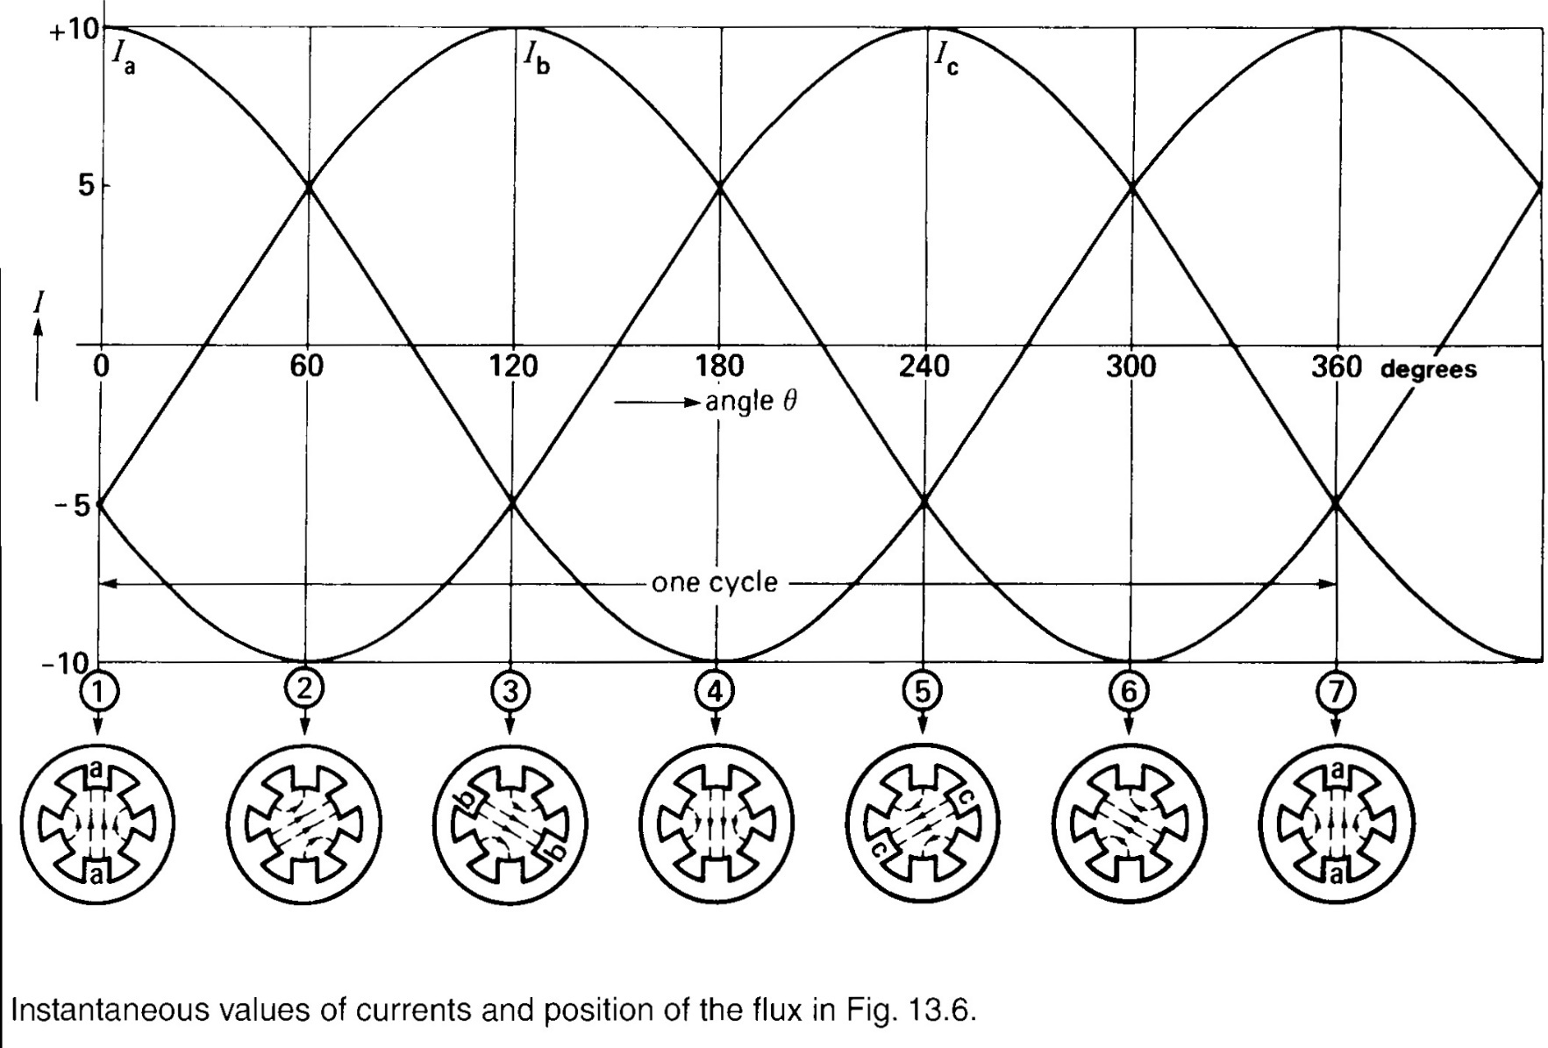
13.3 The rotating field

Slide 13
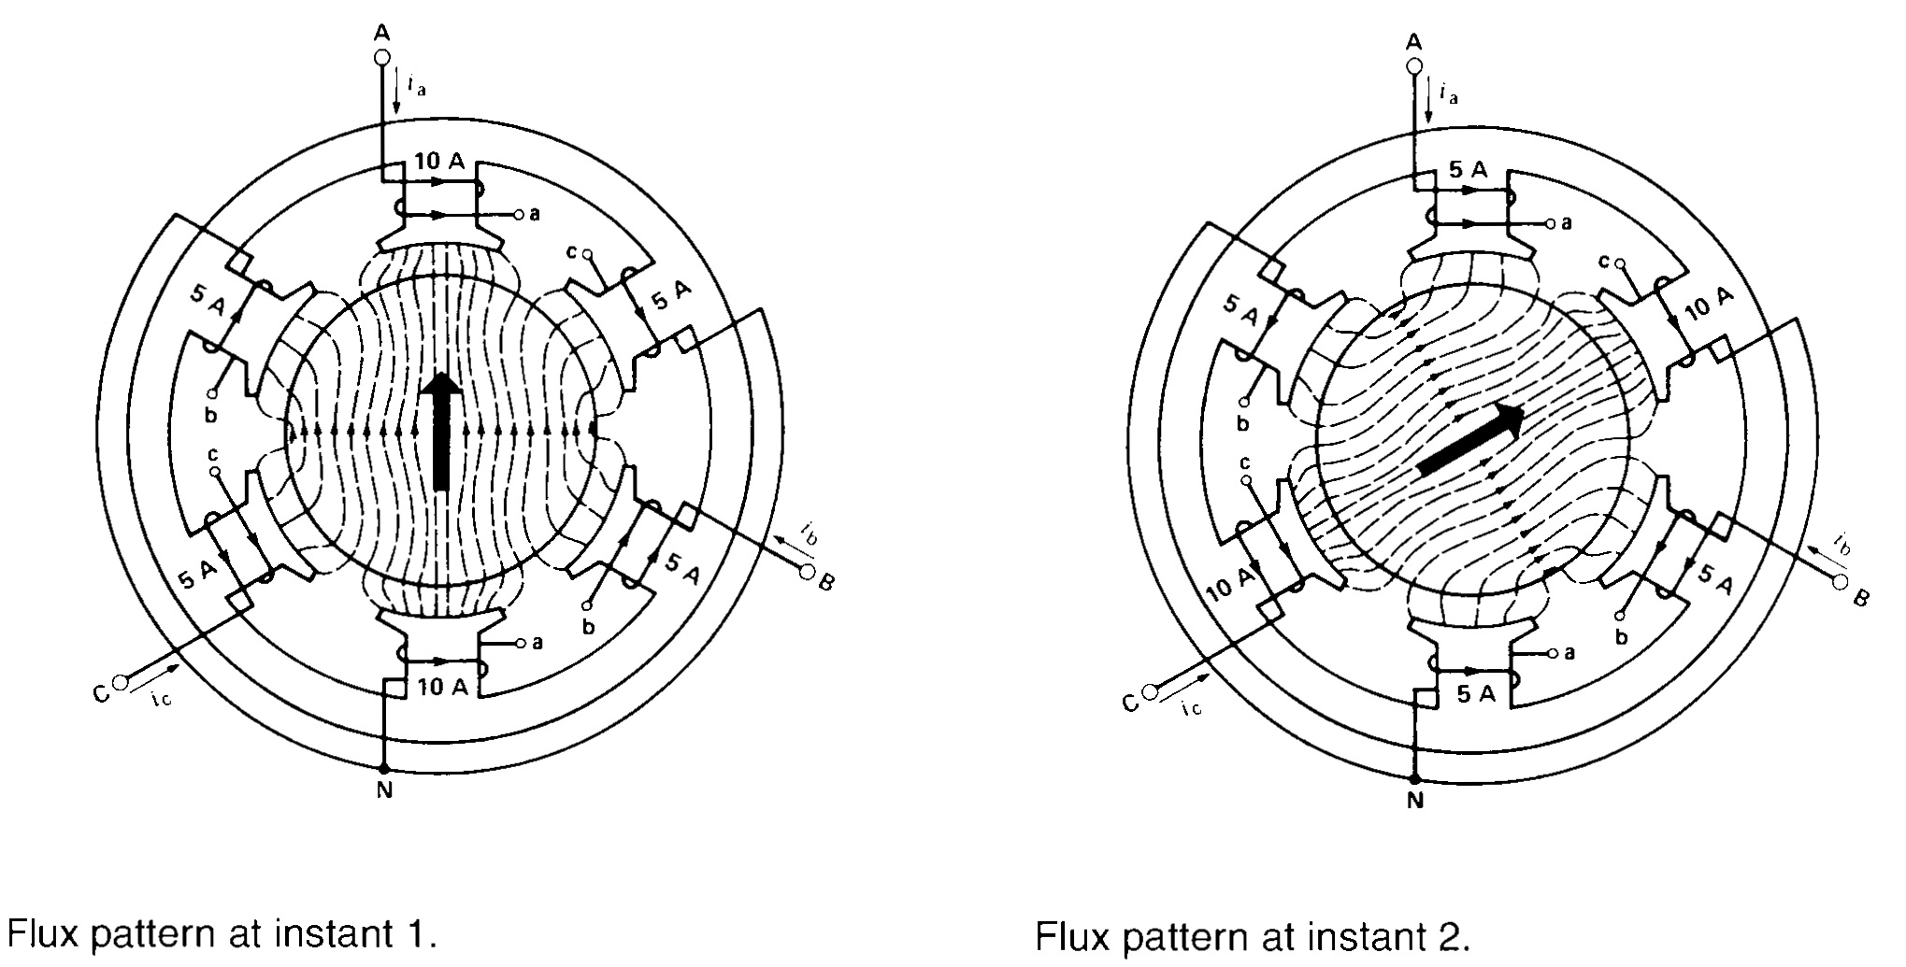
13.3 The rotating field

Slide 14
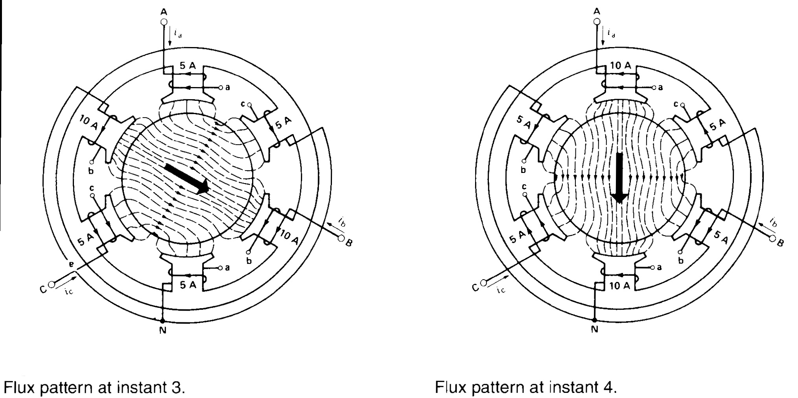
13.3 The rotating field

Slide 15
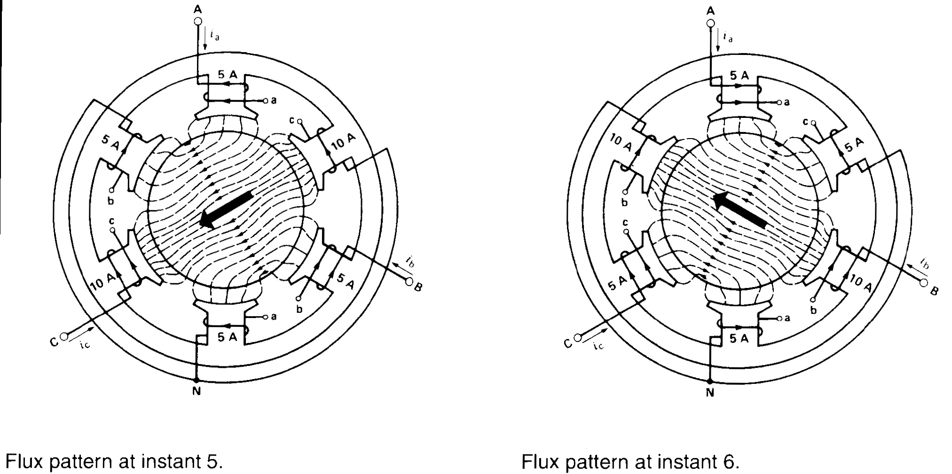
13.3 The rotating field

Slide 16
13.3 The rotating field
Rotational speed of the field depends upon the duration of one cycle which in turns depends upon the source frequency. So , rotational speed is dependent upon the frequency of source
Synchronous speed: Synchronization of speed of rotating filed with the frequency of source is termed as synchronous speed

Slide 17


Slide 18
13.4 Direction of rotation
As shown before crests of current follow the order A-B-C
In this A-B-C order it can also be observed that field rotates CW
Direction of rotating field can be reversed by interchanging any of the two phase. e.g. A-C-B
Field will be keep on rotating at synchronous speed
Two coils of phase A as shown in previous slides have been replaced by two coils because:
180° coil pitch is more efficient as it produces more flux per turn
Three phase coils are separated by 120° in lapping manner
Similarly the pole coil is further sub-divided into more coils instead of using one coil per pole and they are lodged into adjacent slots

Slide 19
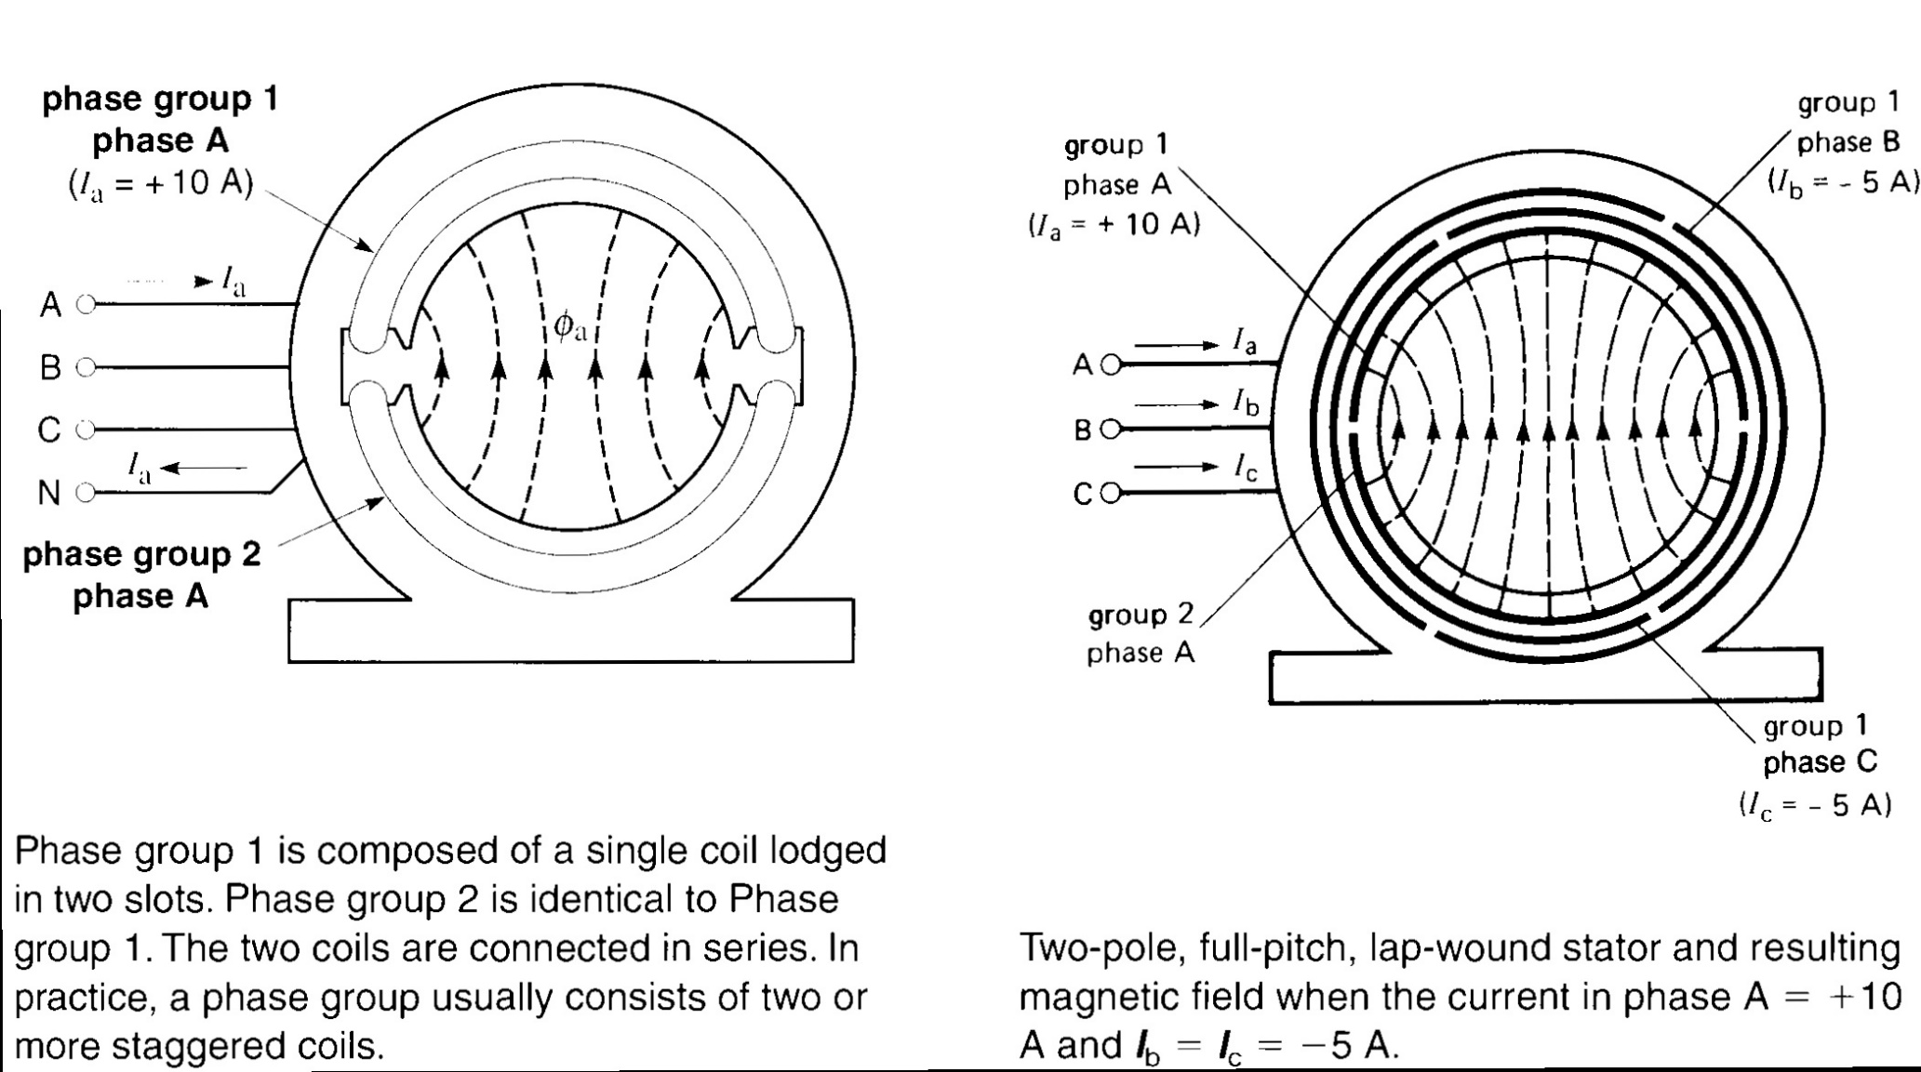
13.4 Improving the performance of induction machine

Slide 20
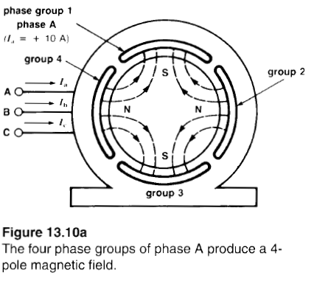
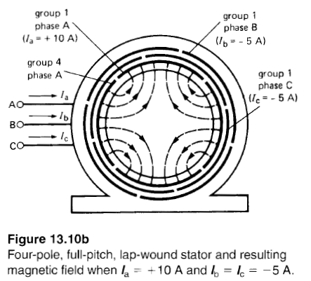
13.5 Number of poles and synchronous speed
Synchronous speed reduces with increasing number of poles

Slide 21
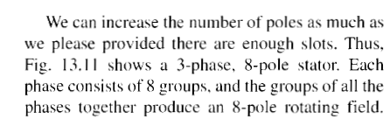
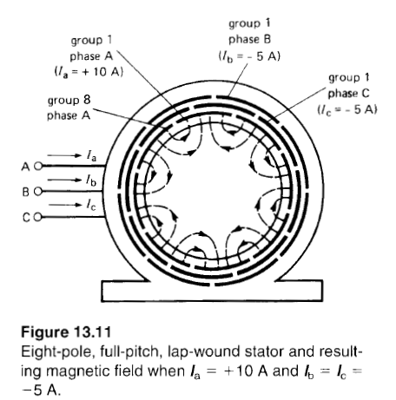
13.5 Number of poles and synchronous speed

Slide 22
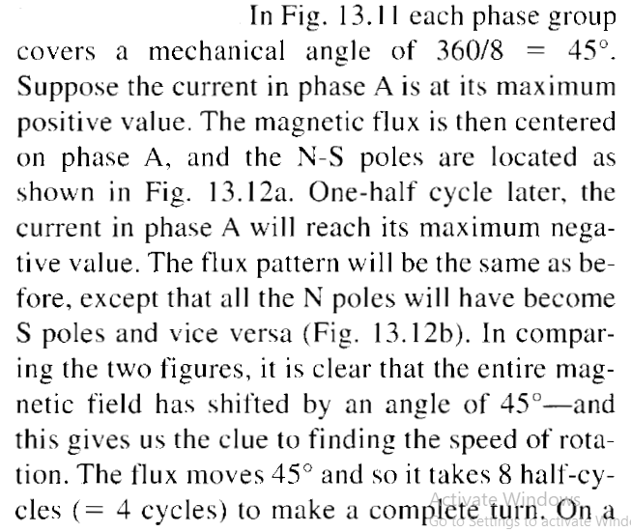
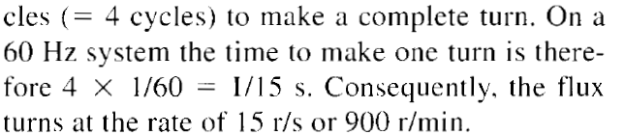
13.5 Number of poles and synchronous speed
Synchronous speed reduces with increasing number of poles

Slide 23
13.5 Number of poles and synchronous speed
Synchronous speed reduces with increasing number of poles

Slide 24
13.6 Starting characteristics of a squirrel-cage motor
Revolving magnetic field is setup when 3-phase supply is connected to stator of induction motor
Revolving field induces the voltage in rotor bars
Induced voltage will result into large circulating current through shorted rotor bars.
Rotor bar will subjected to strong mechanical force because current carrying conductor is placed in magnetic field (Lorentz Law).
Sum of mechanical forces on all rotor bars will produce a torque due to which rotor will rotate in the same direction as that of revolving field.

Slide 25
13.7 Acceleration of the rotor-slip
Slip: Difference between synchronous speed and rotor speed
Rotor speed must be slightly less than synchronous speed because:
If N_{s}=N then:
There will be no flux cutting between rotor and field
No induced voltage in rotor bars
No current in rotor bars
No mmf
No rotation

Slide 26
13.8 Motor under load
Machine speed will fall by loading the machine
With reducing speed the flux cutting will increase due to large change in rotor and synchronous speed due to loading
Hence this increasing in flux cutting will increase induced voltage, current and mmf
A state will come when no more increase will take place, that state in equilibrium state. i.e. Load torque=Motor torque
After developing equilibrium state motor will again rotate at constant speed
Asynchronous machines: Machines that can never rotate at synchronous speed are known as asynchronous machines

Slide 27
13.9 Slip and slip speed
Slip: Difference between synchronous speed and rotor speed
Expressed as a percent of synchronous speed
Per-unit slip is given by the following equation:

Slide 28
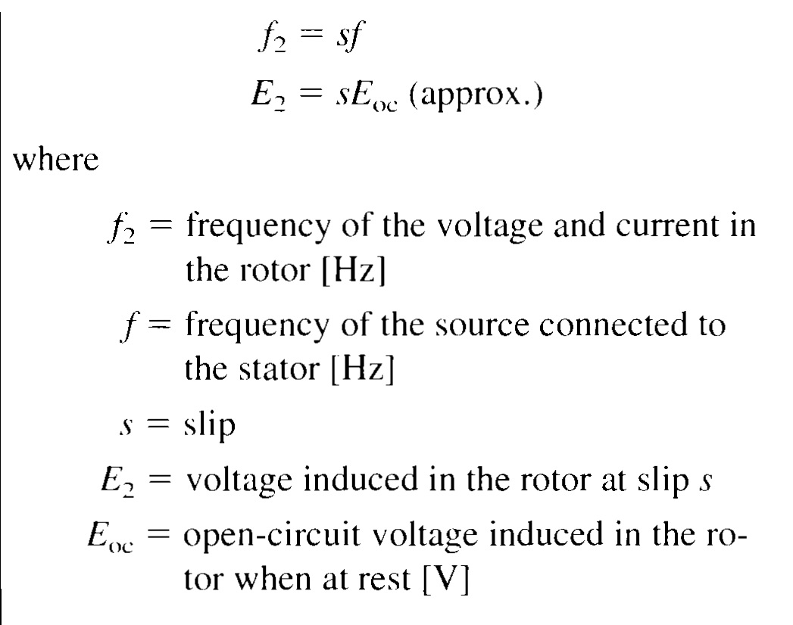
13.10 Voltage and frequency induced in the rotor
Voltage and frequency induced in rotor depends upon slip

Slide 29
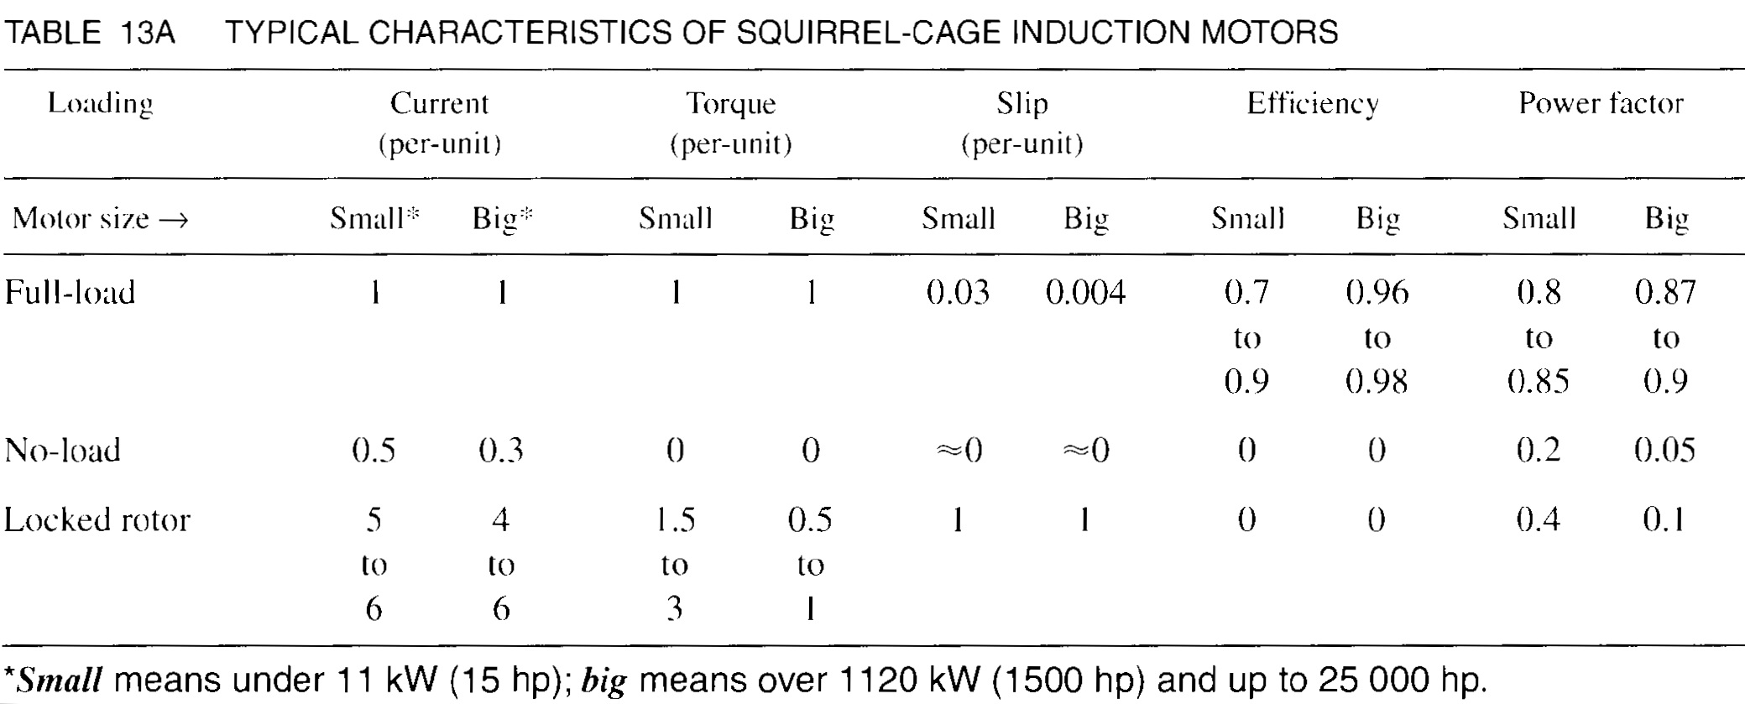
13.11 Characteristics of squirrel-cage induction motor
Properties in the power range between 1kW and 20,000kW is shown in the following table:
Current and torques are expressed in per-unit values
Base current/torque is the full-load current/torque and all other currents/torques are compared to it
Base speed is the synchronous speed of the motor

Slide 30
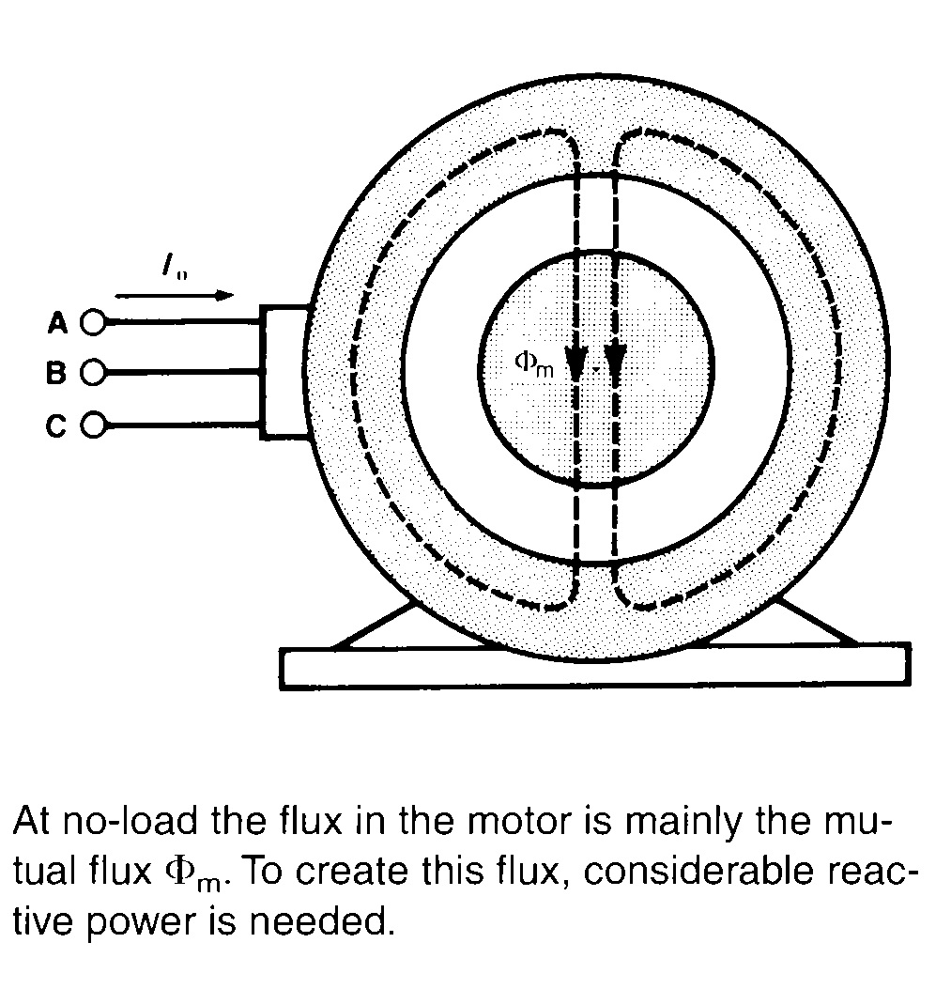
13.11 Characteristics of squirrel-cage induction motor
Motor at no-load:
No-load current lies between 0.5 and 0.3 p.u. of full-load current
No-load current is similar to the exciting current in a transformer and is composed of following two components
Magnetizing component that creates revolving flux ɸ_{m}
Small active component that supplies the windage and friction losses in rotor and iron losses in stator
Flux ɸ_{m} links both stator and the rotor so it is similar to mutual flux in the transformer
Considerable reactive power is needed for creating revolving field and air gap is made short for keeping it within acceptable limits
Power factor at no-load ranges from 0.2 to 0.05
Efficiency at no-load is zero

Slide 31
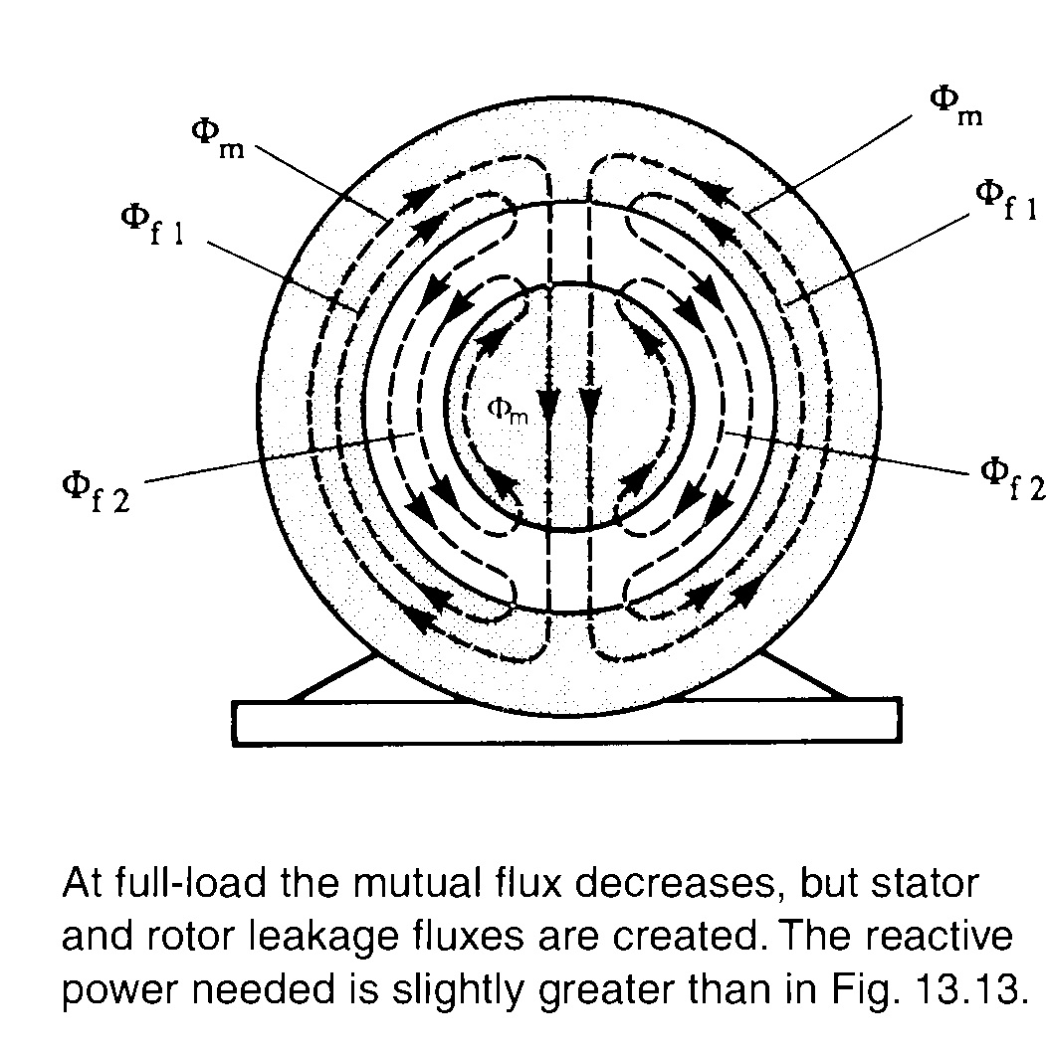
13.11 Characteristics of squirrel-cage induction motor
Motor under load:
Under loading the current in rotor produces mmf which tends to change the mutual flux ɸ_{m}
This sets up an opposing current flow in the stator
Opposing mmfs of both stator and rotor are similar to that of opposing mmfs of primary and secondary of a transformer
As a result, leakage fluxes ɸ_{f1} and ɸ_{f2} are created in addition to mutual flux ɸ_{m}
Active power (kW) absorbed by the motor is almost directly proportional to mechanical load
Power factor of motor increases with increasing mechanical load [Ranges from 0.80 (for small machines) to 0.90 (for large machines) at full-load]
Large efficiency at full-load (Large machines can attain 98%)

Slide 32
13.11 Characteristics of squirrel-cage induction motor
Locked-rotor characteristics:
5 to 6 times of full-load current making I²R losses 25 to 36 times higher than normal. So, rotor must not be locked for more than few seconds
Although mechanical power at standstill is zero, the motor develops a strong torque
Low power factor because considerable reactive power is needed to produce leakages flux in stator and rotor
Leakage fluxes are much larger than that of transformer because of loose coupling of stator and rotor

Slide 33
13.12 Estimating the currents in an induction motor
Full-load current of 3-phase induction motor can be calculated by following equation:
No load and locked rotor current can be calculated from full load current.

Slide 34
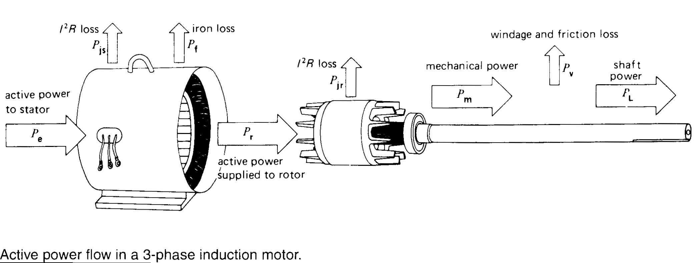
13.13 Active power flow

Slide 35
13.13 Active power flow
Voltages, currents and phasor diagrams enables us to understand the behavior of induction motor but it is preferred to see how electrical energy is converted into mechanical energy by following the active power as it flows through the machine as follows:
Active power (P_{e}) flows from line to 3-phase stator
P_{e} results in stator losses like copper (P_{js}) , iron (P_{f}) [These are dissipated as heat]
Remaining active power (P_{r}) other than losses is transferred to rotor by electromagnetic induction
I²R losses in the rotor results in rotor losses (P_{jr})
Finally remainder of (P_{c}) is available in the form of mechanical power (P_{m})
Subtract P_{v} (small windage and bearing-friction) form P_{m} to get final power P_{L} available at shaft to drive the load

Slide 36
13.13 Active power flow
Power diagram enables to identify and calculate the following important properties of induction motor:
Efficiency:
Efficiency (ɳ)= P_{L} / P_{e}
I²R losses in the rotor:
P_{jr} =s P_{r}
Rotor I²R losses will directly depends upon slip s
Mechanical power:
P_{m} =P_{r}-P_{jr}
P_{m} =P_{r}-s P_{r}
P_{m} =(1-s)P_{r}

Slide 37
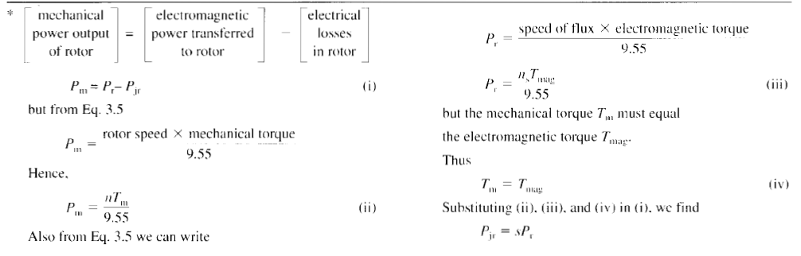
13.13 Active power flow

Slide 38
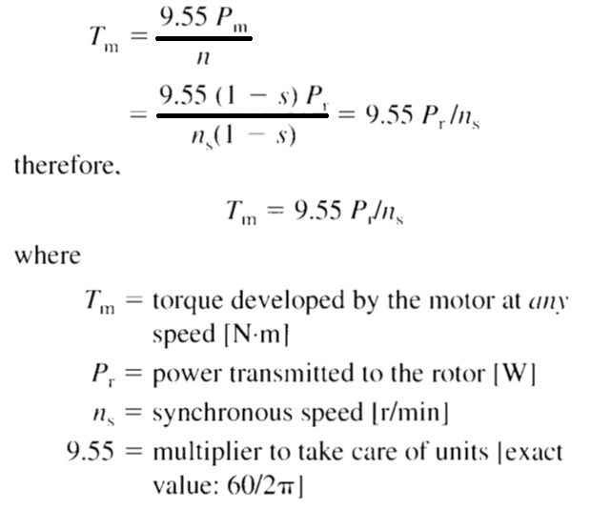
13.13 Active power flow
Power diagram enables to identify and calculate the following important properties of induction motor:
Motor torque:
Due to windage and frictional losses P_{L} and T_{L} will be slightly less than P_{m} and T_{m} respectively

Slide 39
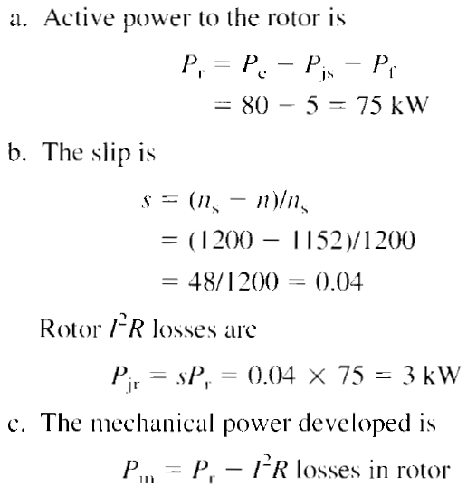
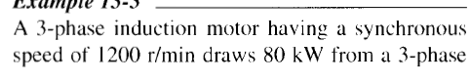
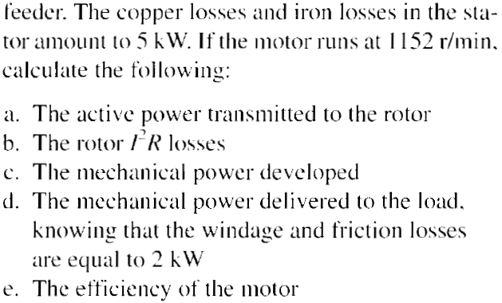
13.13 Active power flow

Slide 40
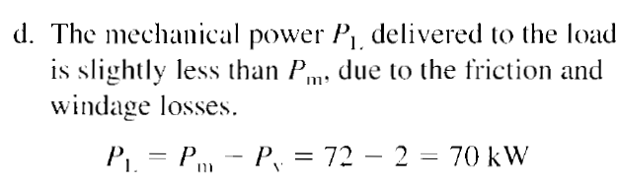
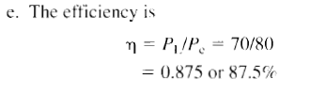
13.13 Active power flow

Slide 41
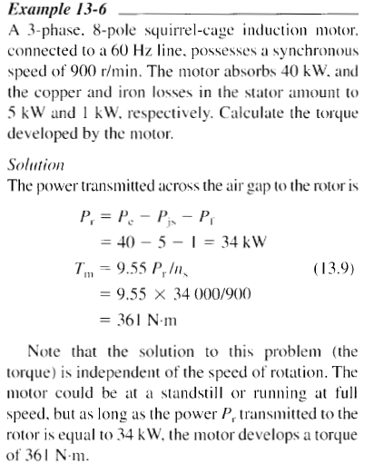
13.13 Active power flow

Slide 42
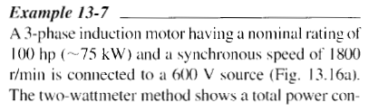
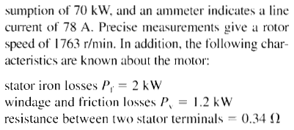
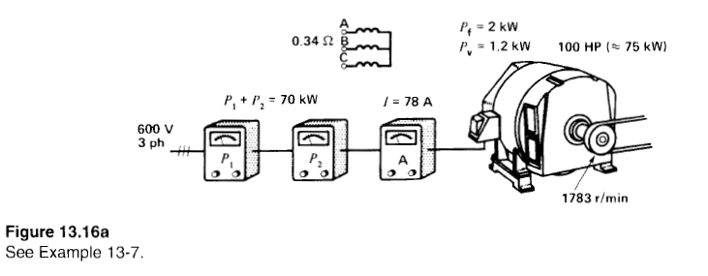
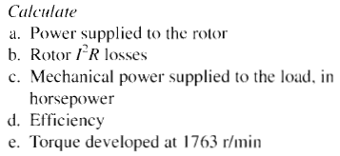
13.13 Active power flow

Slide 43
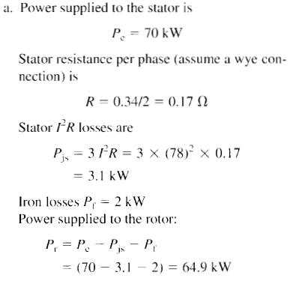
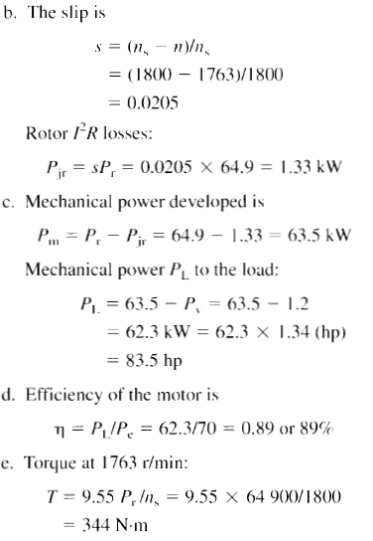
13.13 Active power flow

Slide 44
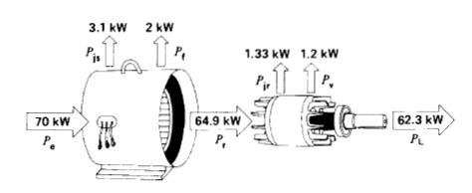
13.13 Active power flow

Slide 45
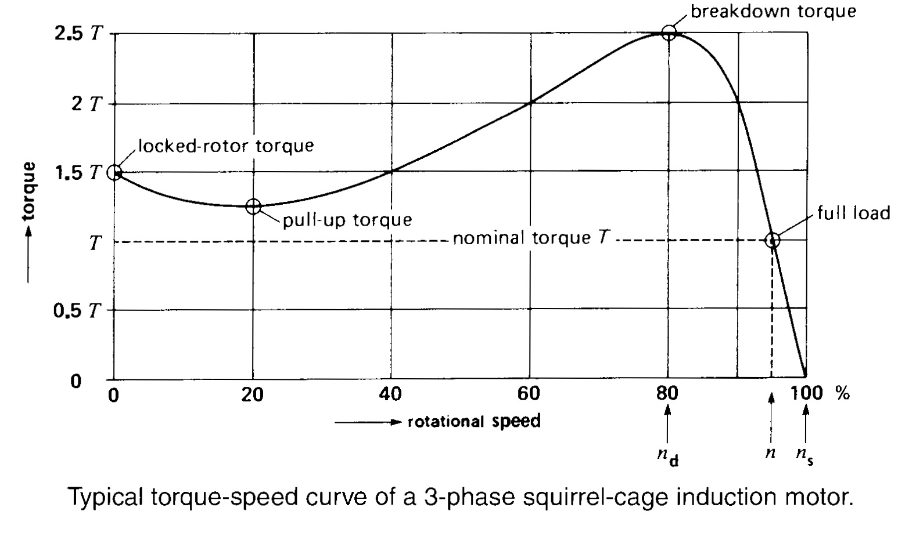
13.14 Torque versus speed curve
Starting torque
Maximum torque
Motor torque depends upon its speed but the relationship between torque and speed can not be expressed by simple equation. It is preferred to show their relationship in the form of curve
At full load motor runs at speed n, Nominal torque T lies on full load
1.Locked rotor torque, 2.pull up torque, 3. breakdown torque
With increasing mechanical load motor speed will drop until the motor torque is again equal to the load torque. When again two torques are in balance, motor will start running at constant but at slightly less speed as that of before
Motor will come to quick stop if load torque becomes greater than breakdown torque
n_{d}=Speed at breakdown torque
For small machines n_{d}=80% of n_{s}
For large machines n_{d}= 98% of n_{s}
Minimum torque developed by motor while it is accelerating from rest to breakdown torque

Slide 46
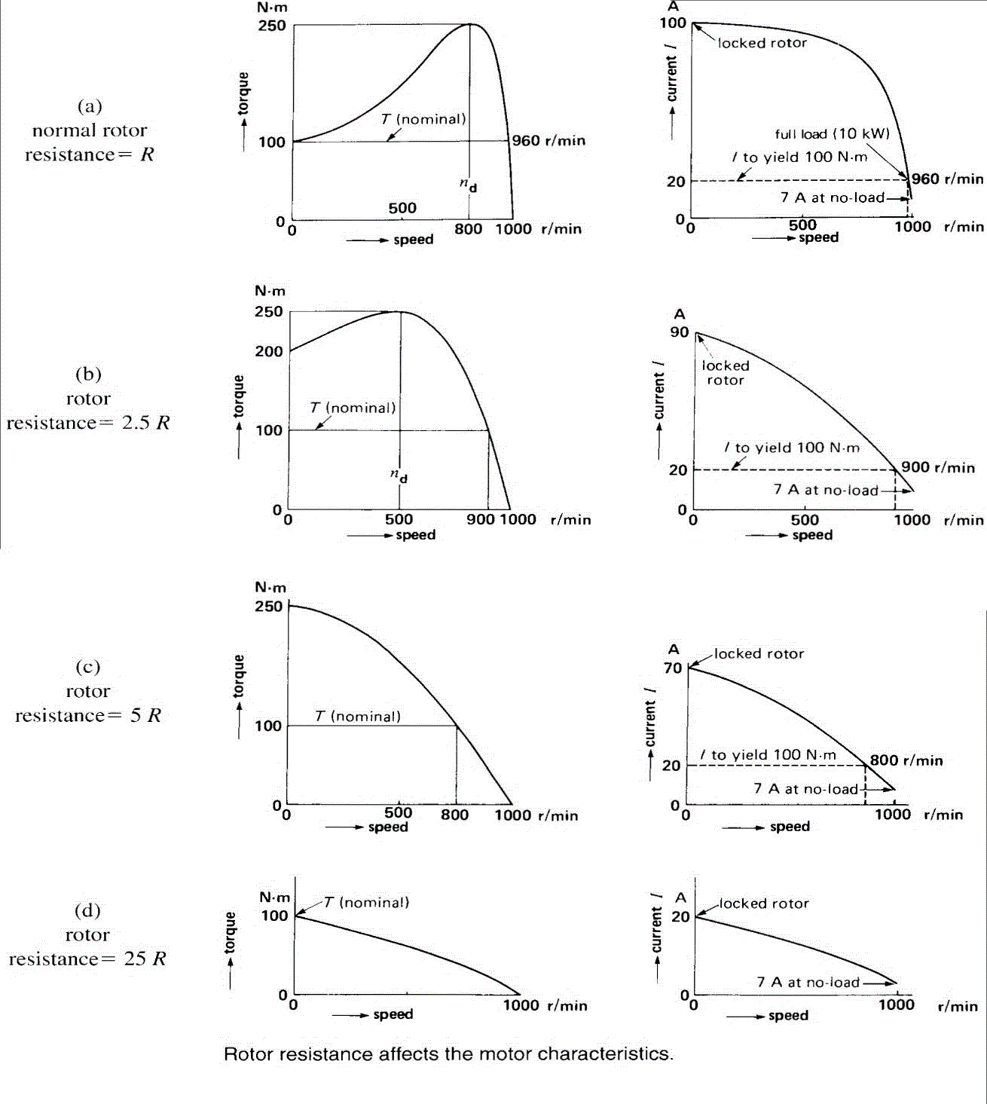
13.15 Effect of rotor resistance

Slide 47
13.15 Effect of rotor resistance
Resistance of squirrel-cage rotor is essentially constant from no-load to full-load
Rotor resistance changes with change in temperature. So, resistance increases with increasing load because temperature rises
Rotor resistance is also dependent on the material (copper, aluminum or other metals) used
Torque-speed curve is greatly effected by change in resistance
Summary:
High starting rotor resistance is desirable because:
High starting torque
Low starting current
Low running rotor resistance is desirable because:
Low losses in running condition
Drop in speed is less with increasing load
High efficiency

Slide 48
13.15 Effect of rotor resistance
Disadvantage of high starting resistance:
Rapid fall-off in speed with increasing load
Slip is high
Motor I²R losses are high
Motor tends to heat up
Wound-rotor induction machine: Those which can provide high starting resistance and low running resistance
Wound-rotor is to be used for wide variation in resistance and it allows us to vary the rotor resistance at will by means of external rheostat

Slide 49
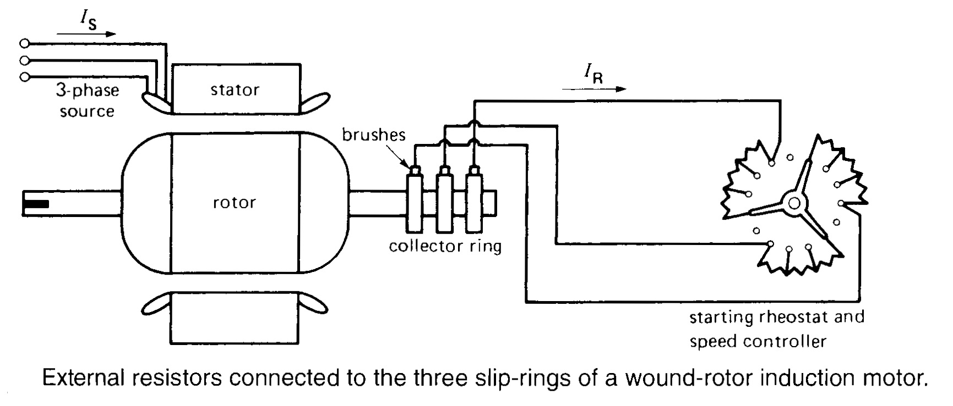
13.16 Wound-rotor motor

Slide 50
13.16 Wound-rotor motor
Construction:
wye-connected external resistors by means of set of slip-rings and brushes
Working:
Under locked-rotor conditions, resistance value is set to the highest
As the motor speeds up resistance is gradually reduced until full-load speed is reached, where brushes are short circuited
Wound-rotor motor costs more but it offers following advantages:
By inserting three external resistors locked-rotor current can be reduced drastically with even higher stating torque than that of squirrel-cage motor
Speed can be varied by varying the external rotor resistance
Liquid rheostat for large machines because of large thermal capacity that will result in less temperature rise
Motor is best for running high inertial loads which require long time to bring up to speed

Slide 51
Summary
Course Ch#13
Topics: 13.1-13.16
Examples 13.1-13.7 (Assignment)

